Slide 1
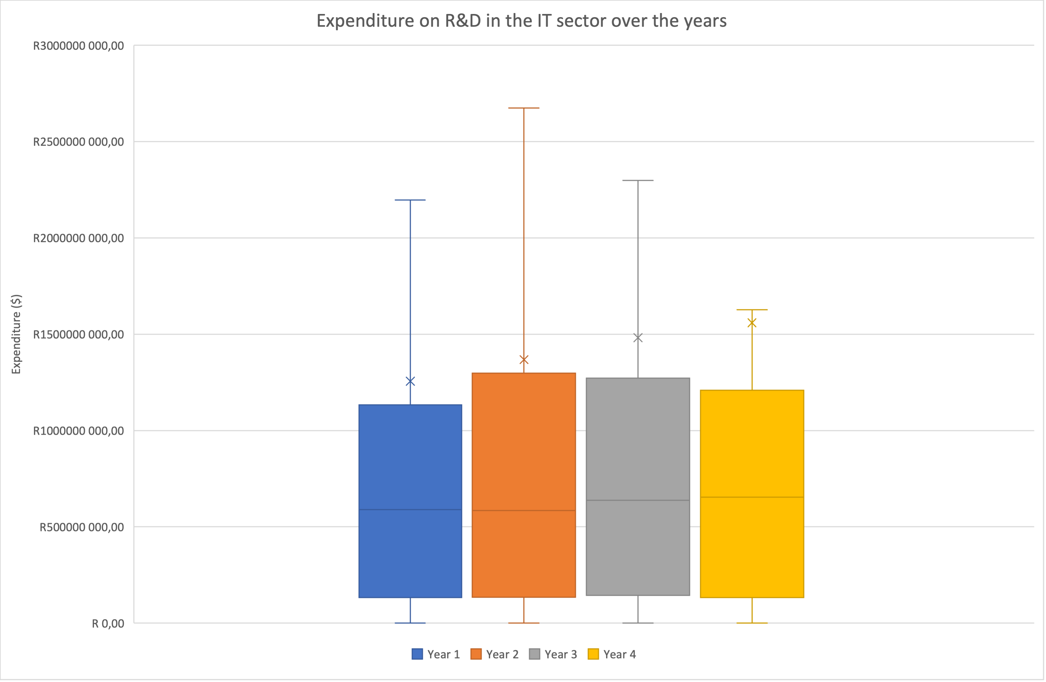
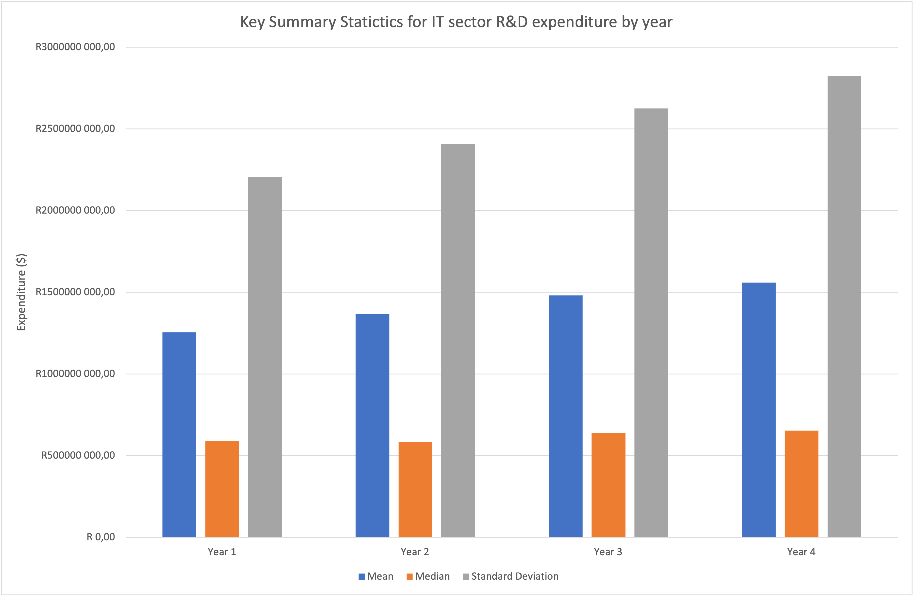
How has the expenditure for research and development for companies in the 'Information Technology' sector changed over the years?
To the left are boxplots for the expenditure on R&D for companies in the IT sector over the years. (The next slide displays outliers). A bar chart shows the mean, median and standard deviation over the years for the IT sector as well.
The mean expenditure for IT has steadily increase by $100 million year on year. It initially was $1.25 billion in year 1 and by year 4 it is $1.55 billion. In contrast, the median spend has remained fairly steady with its change over the same period being $63 million. It is also noted that the mean spend is significantly greater than the median spend – a few outlier companies skew this data. (refer to next slide).
Standard deviation is also consistent with the mean expenditure trend. It has increased by $200 million each year. This increase in mean and standard deviation suggests that not only is the R&D expenditure growing, but it is also becoming more variable or dispersed over the years. It could be inferred that some companies might be significantly increasing their R&D expenditures, while others may not be increasing them as much or might even be decreasing them.

Slide 2
